Slide 1
Market Structure

Slide 2
Industry
Industry (market) – a collection of firms, each of which is supplying products that have some degree of substitutability, to the same potential buyers
Common buyers for sellers
Common sellers for buyers
Relatively homogeneous product

Slide 3
Market Structure
Market Structure – those characteristics of the market that significantly affect the behavior and interaction of buyers and sellers
number and size of sellers and buyers
type of the product
conditions of entry and exit
transparency of information

Slide 4
Market Structure
Perfect
Competition
Pure Monopoly
More competitive (fewer imperfections)
Less competitive (greater degree of imperfection)

Slide 5
Market Structure
Perfect
Competition
Pure Monopoly
Monopolistic Competition
Oligopoly
Duopoly
Monopoly
The further right on the scale, the greater the degree
of monopoly power exercised by the firm.

Slide 6
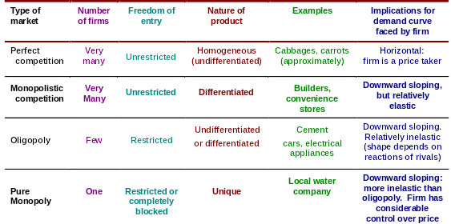
Features of the market types

Slide 7
Perfect Competition Market
Structure:
Many buyers and sellers
Buyers and sellers are price takers
Product is homogeneous
Perfect mobility of resources
Economic agents have perfect knowledge

Slide 8
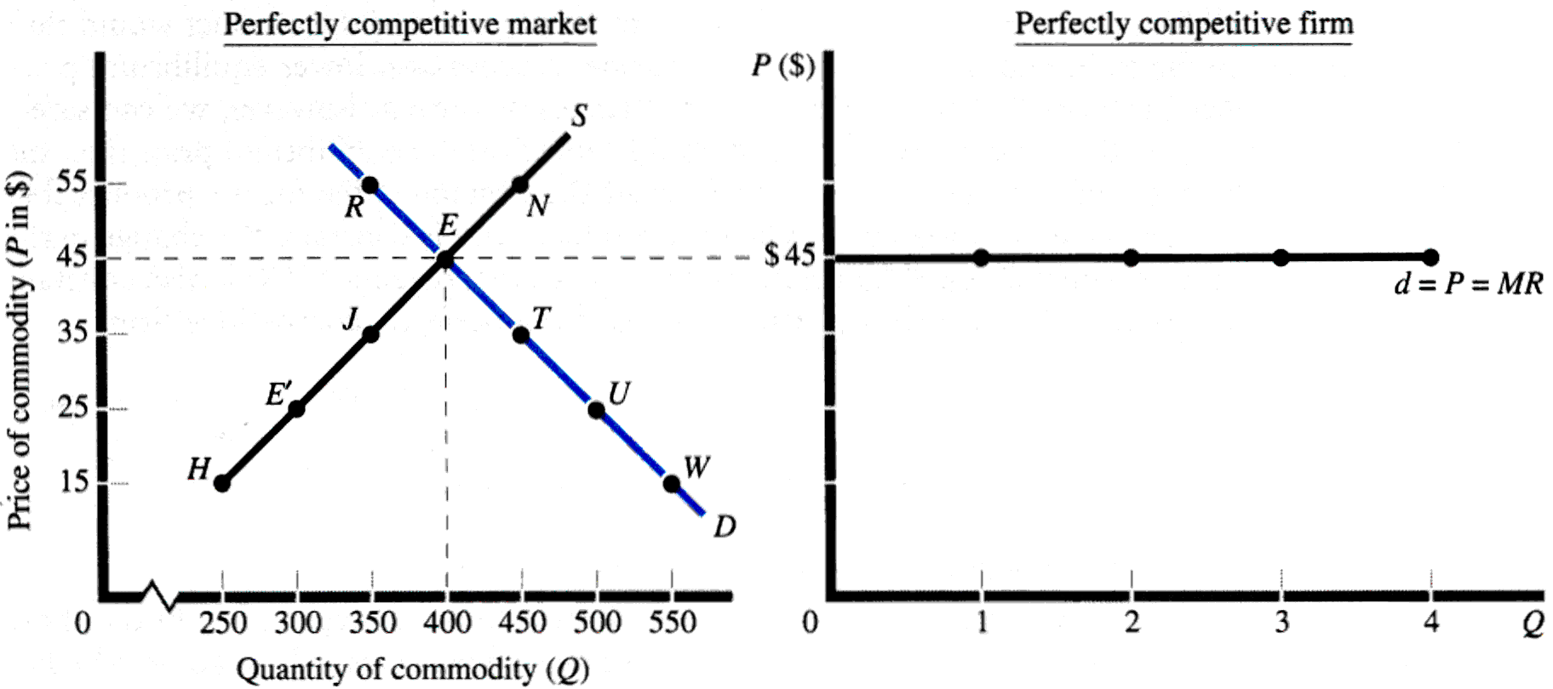
Price Determination
The individual firm takes the market price as given.

Slide 9
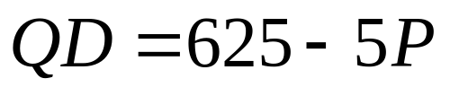
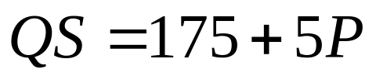
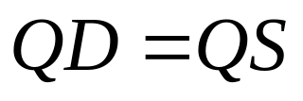



Price Determination

Slide 10
Short-run and Long-run
In the short run, one factor of production is fixed, usually the plant size.
  Firms cannot enter or leave the industry.
In the long run, all factors are variable.
  Firms will enter the industry in response to profits.
  Firms will leave the industry in response to losses.

Slide 11
Profit Maximization
Total Profits = TR -TC
dΠ = d(TR) - d(TC) = 0
dQ dQ dQ
MR - MC = 0
MR = MC
d(TR) = d(PQ) = P = MR
dQ dQ

Slide 12
Short-run equilibrium
Firm’s Demand Curve = Market Price
= Marginal Revenue
Firm’s Supply Curve = Marginal Cost
where Marginal Cost > Average Variable Cost

Slide 13
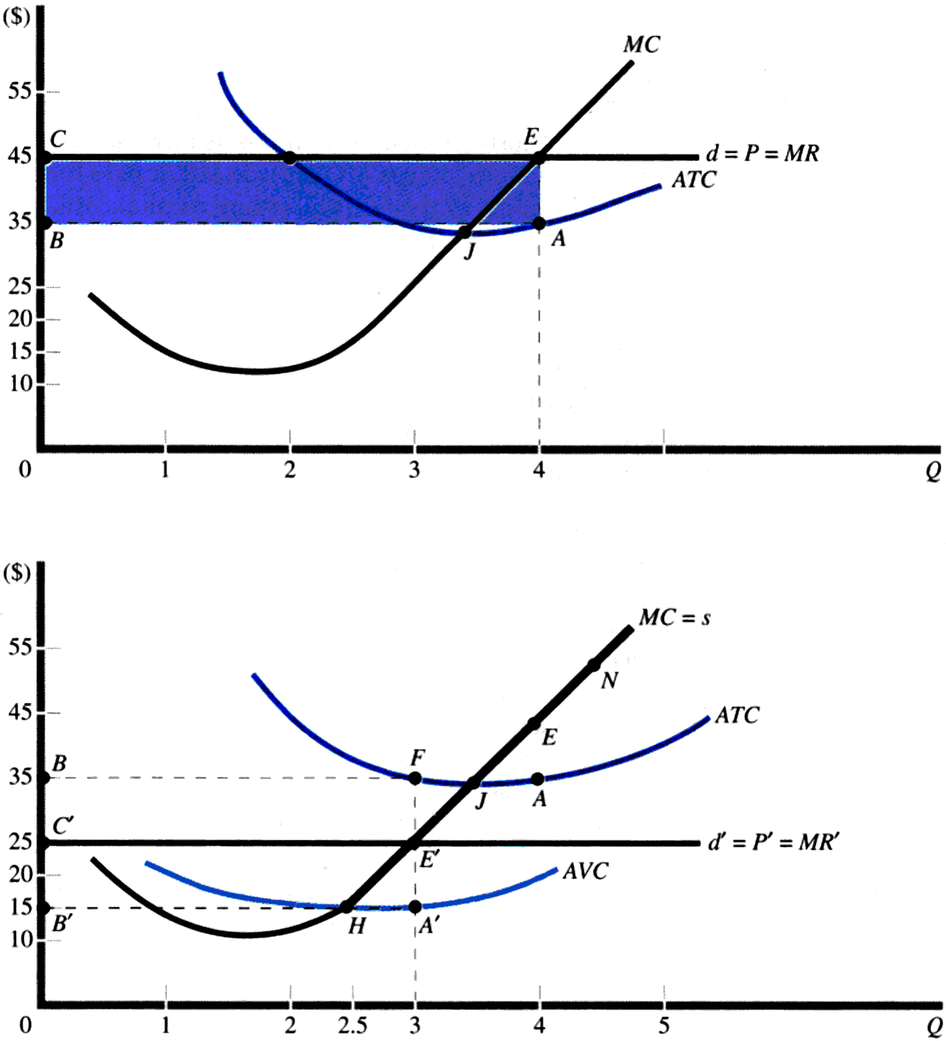
Short-run equilibrium

Slide 14
Short-run decisions
Competitive firms are price takers, so they can sell all they want at the going market price. As a result, their marginal revenue is equal to product price.
The demand curve facing the competitive firm is a straight line demand at market price.
Competitive firms will maximize profit by producing that output where marginal revenue equals marginal cost (MR = MC).
When price is greater than the minimum point of average total cost, firms earn economic profits.

Slide 15
Short-run decisions
When price is just equal to the minimum point of average total cost, firms earn normal profits.
When price is below the minimum point of average total cost, but above the minimum point of average variable costs, the firm continues to operate at a loss.
When price falls below the minimum point on the average variable cost curve, the firm will shut down and incur a loss equal to the amount of total fixed costs.
The short run supply curve of the firm is the marginal cost curve above the minimum point on the average variable cost curve.

Slide 16
Short-run decisions

Slide 17
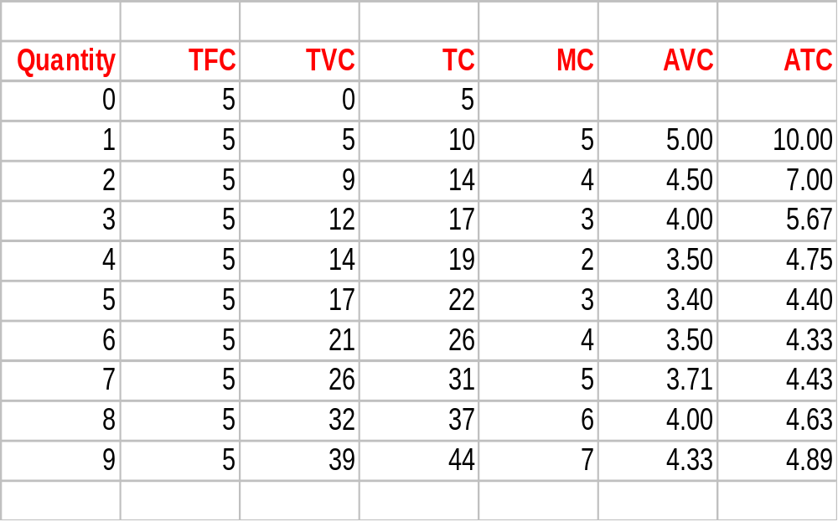
Losses and Shutdown Decision

Slide 18
Losses and Shutdown Decision
12
Price, cost
per unit
10
8
MC
6
C
ATC
5
4
AVC
3.35
2
0
0
1
2
3
4
5
6
7
8
9
10
Quantity per period

Slide 19
Losses and Shutdown Decision
Price, cost
per unit
12
10
8
MC
6
C
ATC
5
4
B
AVC
3.35
2
0
0
1
2
3
4
5
6
7
8
9
10
Quantity per period

Slide 20
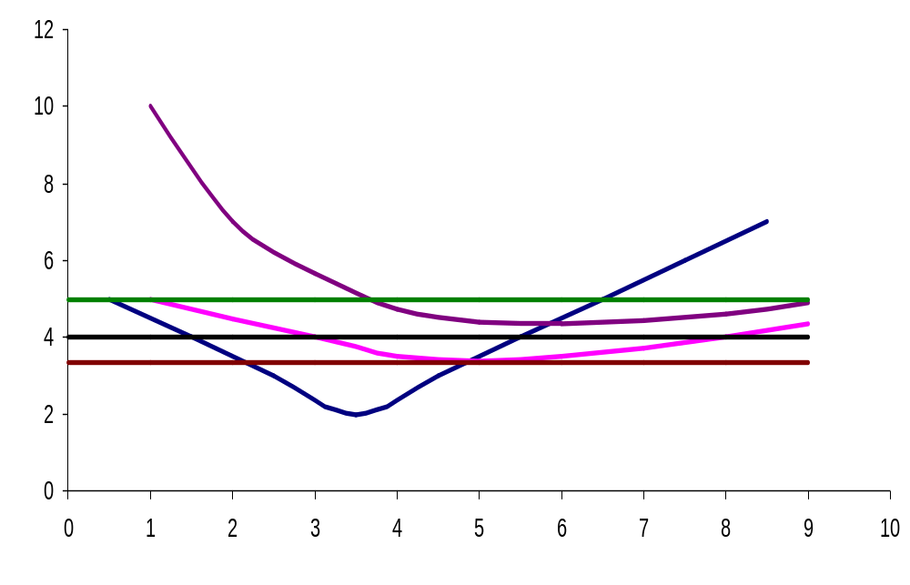
Losses and Shutdown Decision
Price, cost
per unit
MC
C
ATC
5
B
AVC
3.35
A
Quantity per period

Slide 21
Long-run Adjustments
If firms in the industry are earning short run economic profits, new firms can be expected to enter the industry in the long run, or existing firms may increase the scale of their operations.
Losses will lead to the exit of some firms.
Final equilibrium in the long run is the point at which industry price is just tangent to the minimum point on the ATC curve.

Slide 22
Long-run Adjustments
In long run equilibrium, the firm will earn zero economic profit, and the market will produce the maximum possible consumer and producer surplus.
MC
Consumer
Surplus
P
P
P=ATC
Producer
Surplus
Industry
Firm

Slide 23
Long-run Adjustments
When competitive firms are earning short run economic profits, these profits attract firms into the industry.
  Supply increases and market price falls until firms are earning zero economic profits.
Losses mean that some firms will leave the industry. This reduces supply, increasing prices until profits return to normal.
Competitive markets are efficient because
P = MR = MC = SRATC_{min} = LRATC_{min}.

Slide 24
Long-run Adjustments
Competitive markets are productively efficient because products are produced at their lowest possible opportunity cost.
Competitive markets are allocatively efficient because P = MC and consumer and producer surplus is at a maximum.

